Slide 1


How to Enhance that UI with PCF
Rami Mounla
Solution Architect | Power Platform | DXC NZ

Slide 2
You, Me, and the Power Platform

Slide 3
What is the Power Platform Component Framework?

Slide 4
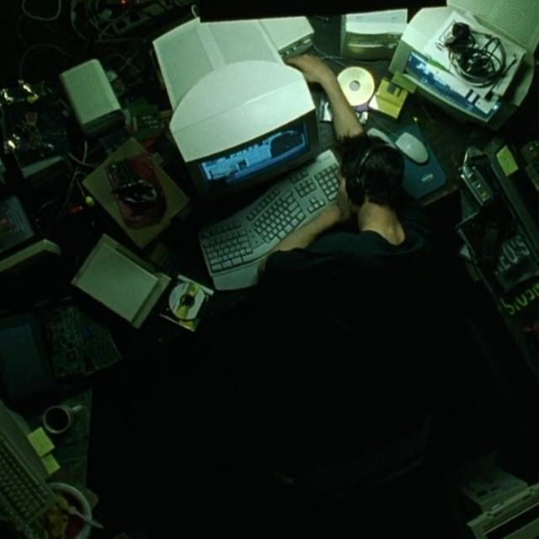

Slide 5
Examples

Slide 6
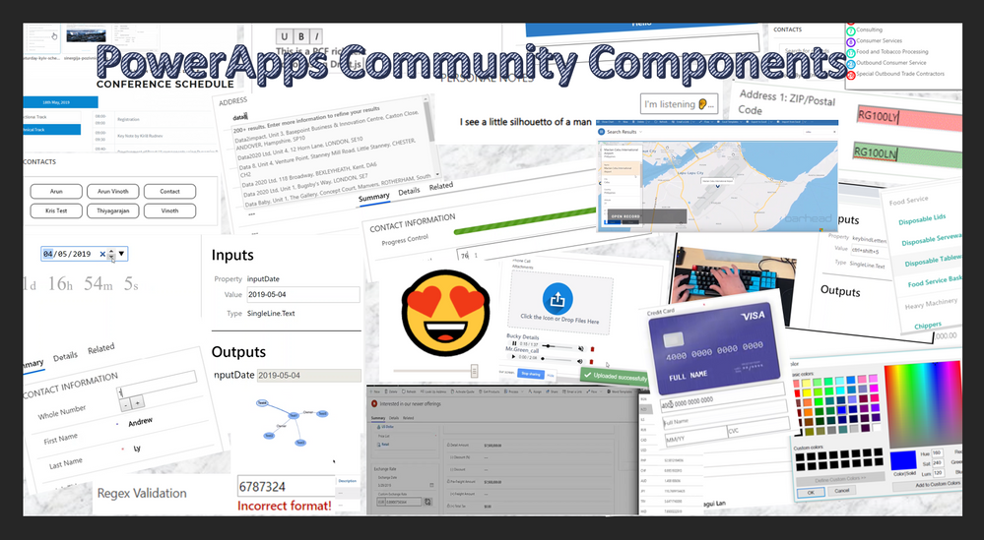

Slide 7
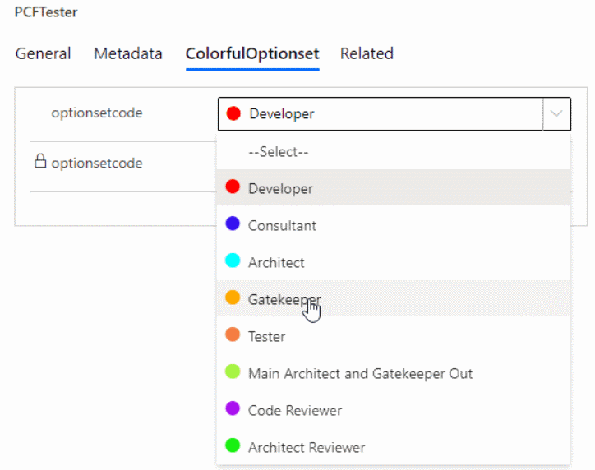

Slide 8
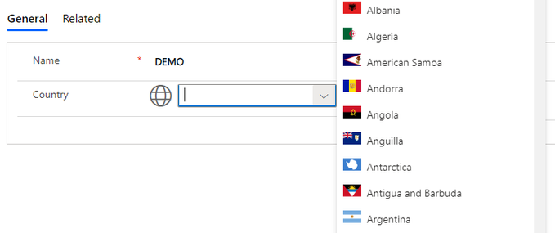

Slide 9
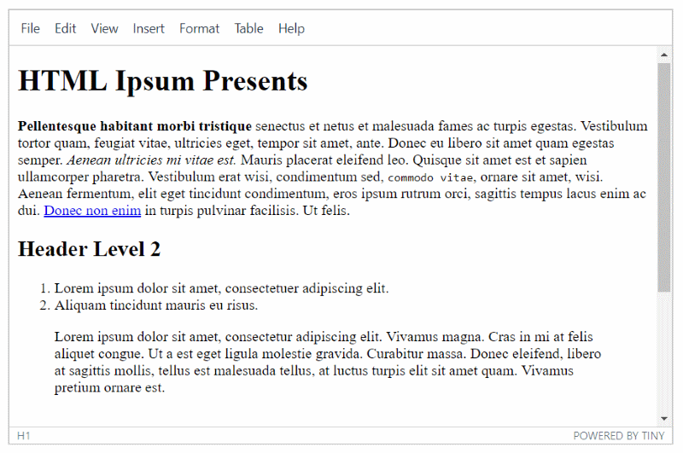

Slide 10
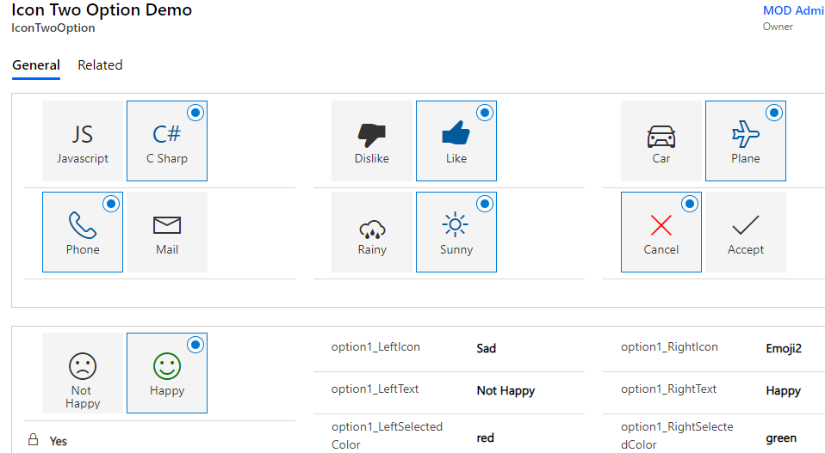

Slide 11
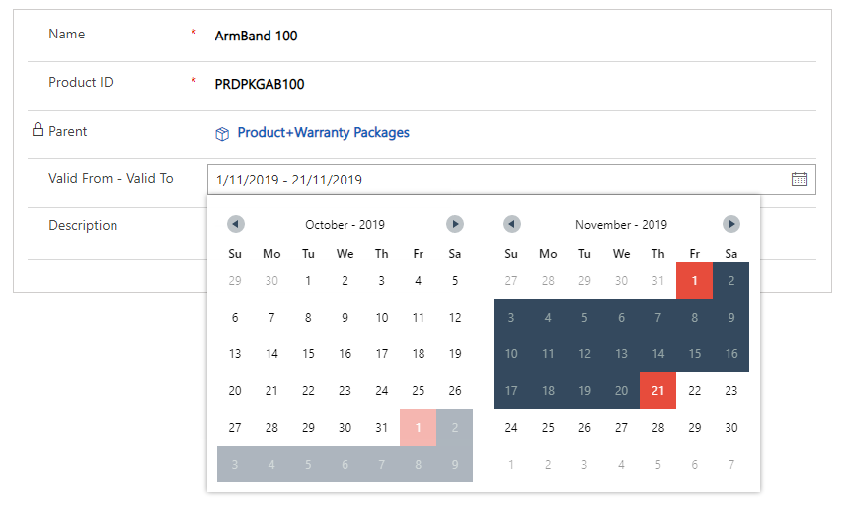

Slide 12
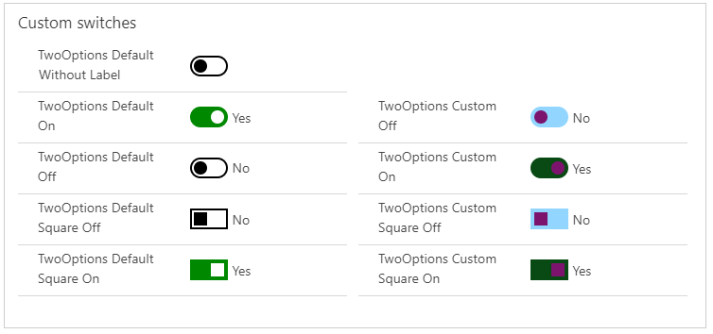

Slide 13
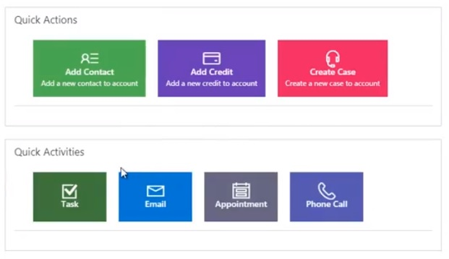

Slide 14
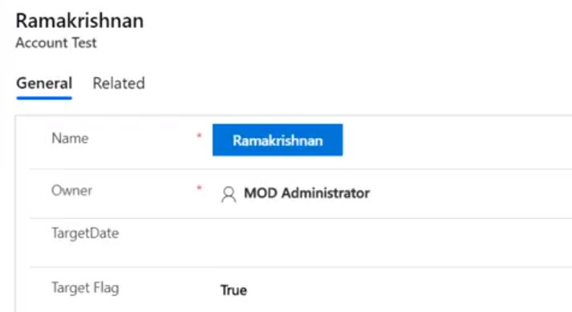

Slide 15
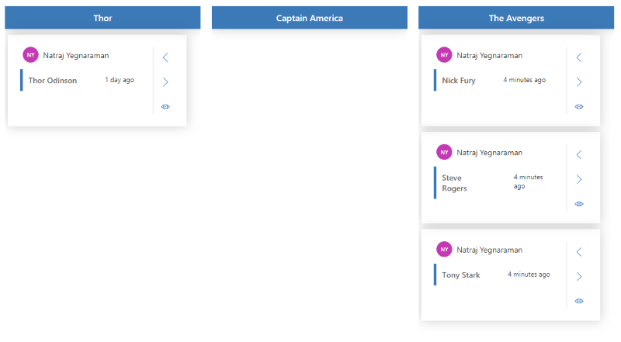

Slide 16
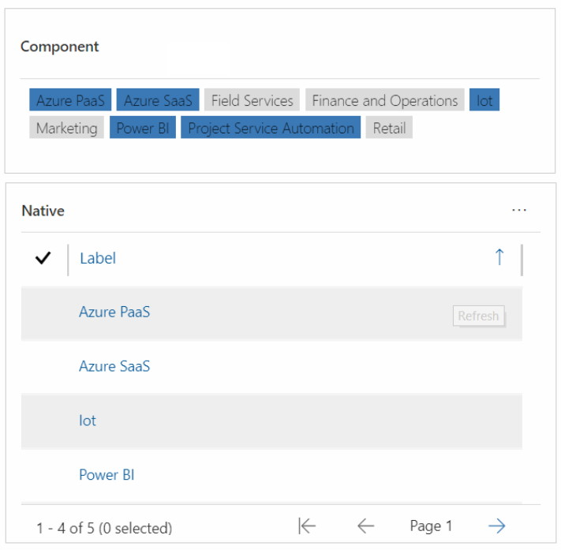

Slide 17
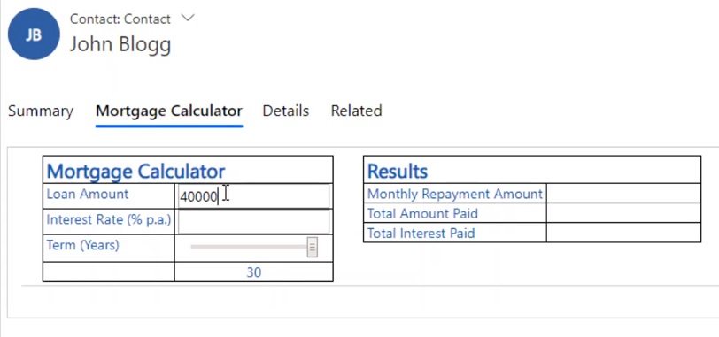

Slide 18
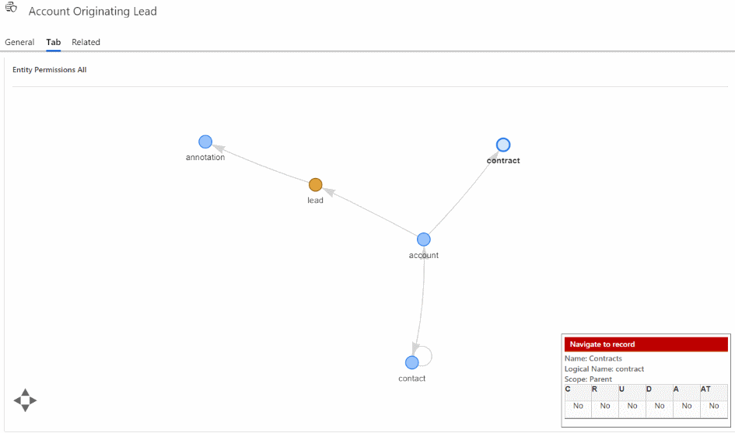

Slide 19
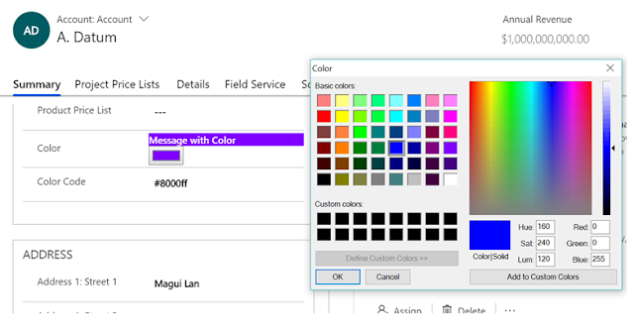

Slide 20
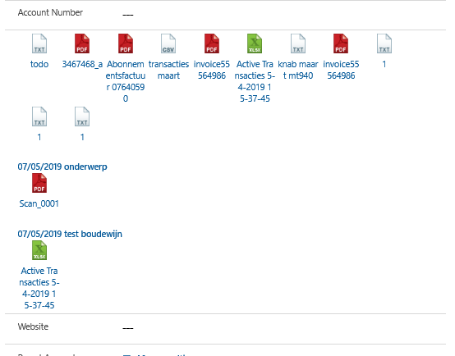

Slide 21
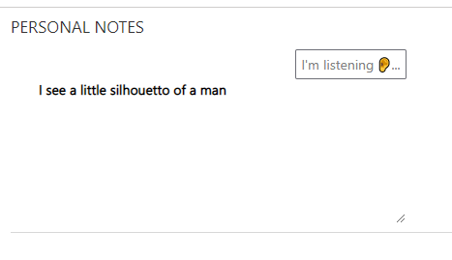

Slide 22
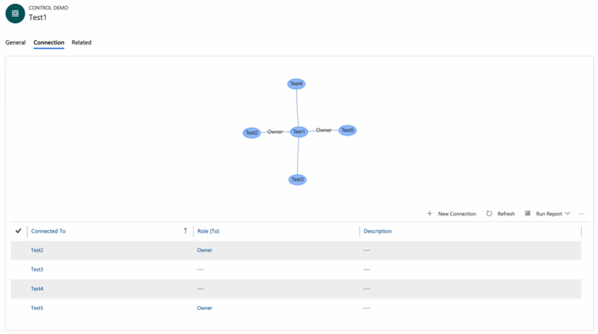

Slide 23
NZ specific ones

Slide 24
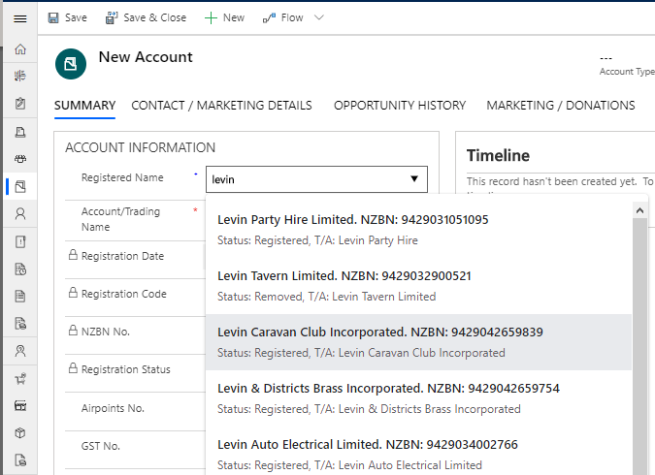

Slide 25
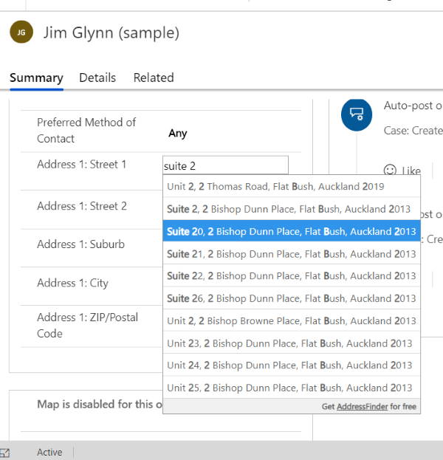

Slide 26
Field v Data Sets

Slide 27
Learning Curve
What you need to know

Slide 28
Technologies
NPM
TypeScript
HTML + CSS

Slide 29


Slide 30
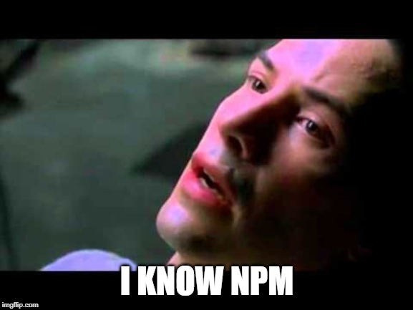

Slide 32
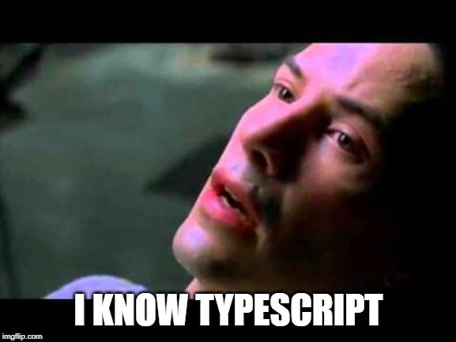

Slide 33
The 8 Commands
That you need to know

Slide 34
Cheat Sheet Create Control
pac pcf init --namespace XrmEnterprise --name CalendarView --template dataset
1. pac pcf init --namespace XrmEnterprise --name Tile --template field
2. npm install
3. npm run build
4. npm start

Slide 35
Cheat Sheet Package Control
5. pac solution init --publisher-name XrmEnterprise --publisher-prefix xe
6. pac solution add-reference --path ..\CalendarView
7. msbuild /t:restore
8. msbuild

Slide 36
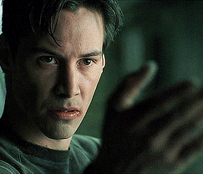

Slide 37
Example: Field

Slide 38
Example: Data Set

Slide 39


Slide 40
My Examples

Slide 41
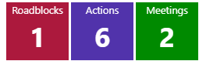


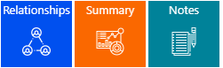

Slide 42
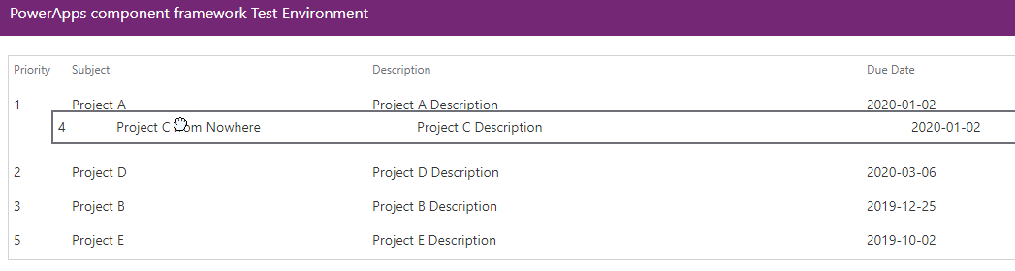

Slide 43
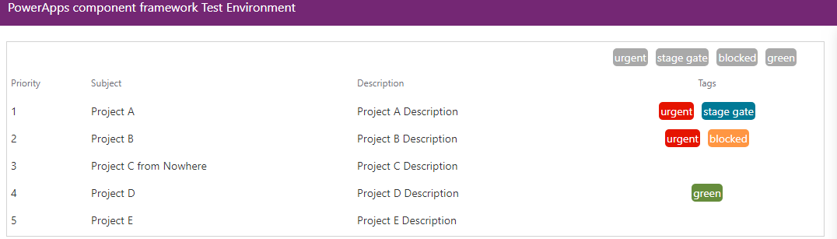

Slide 44
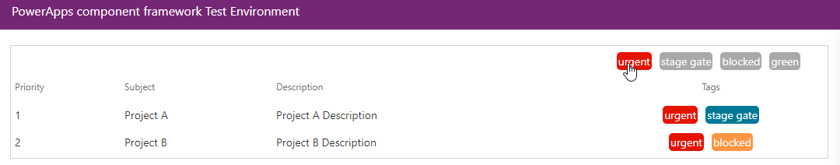

Slide 45
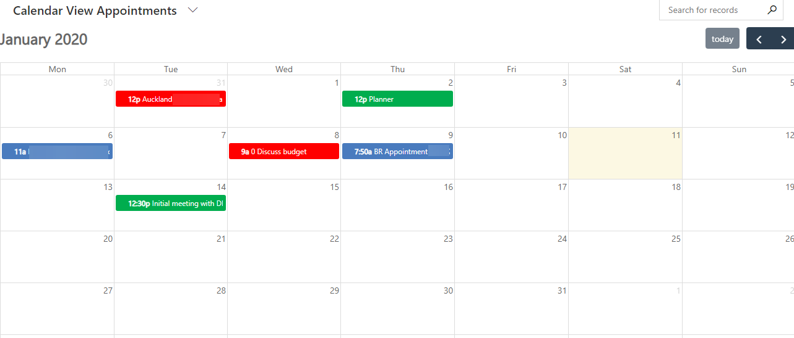

Slide 46
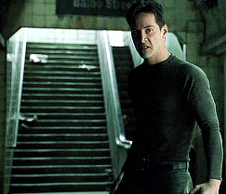

Slide 47


Slide 48
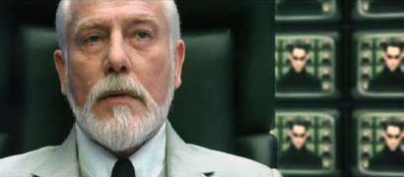
Useful links
Microsoft Documentation
https://docs.microsoft.com/en-us/powerapps/developer/component-framework/overview
Rami’s Samples
https://github.com/ramimounla
PCF Gallery
https://pcf.gallery/
Andrew Butenko
https://www.youtube.com/channel/UCjXCqDkRAGFAtu2JlWr3Epg

Slide 49

Thank you

